Slide 1
Talking Point
Speaking clearly and confidently – being proud to succeed at Barr bEACON

Slide 2
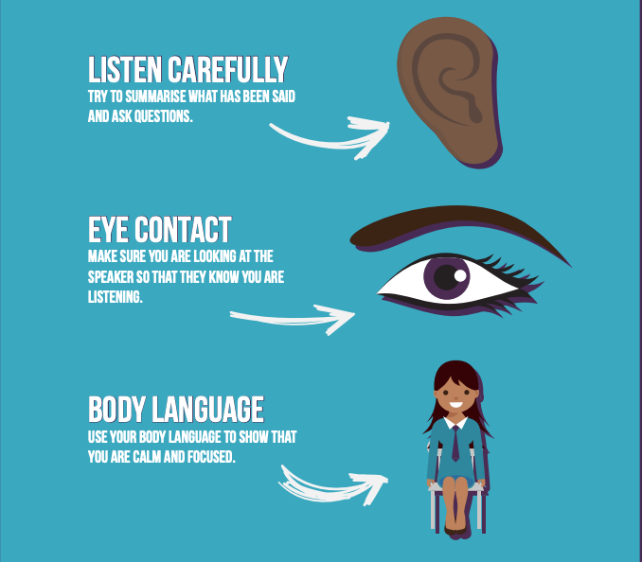
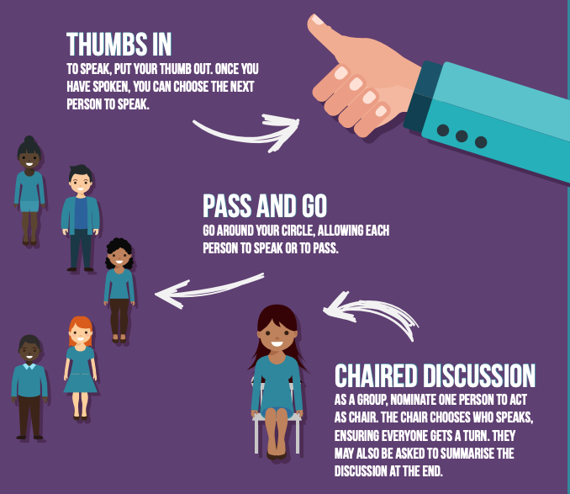
Top tips for Talking at Home:
Ground rules: It is important to establish ground rules for both you and your family/conversation group. Clear expectations for listening and speaking can make having discussions more effective and more purposeful.
No devices, mobile phones or distractions should be an enforced expectation to provide you with some focused time to talk…and listen to one another.
Here are some suggested ways to bring order to your discussion:

Slide 3
Keeping the conversation going:
Consider asking questions, ‘explain what you mean by…’ as a way of extending talk and consolidating points that are being discussed.
Asking ‘Can you tell me more about…?’ or ‘Why do you think…?’ can help involve conversation group members.
You could even pose a new challenge by saying ‘I wonder if…’ as this can help move talk on or develop ideas further.

